Slide 1
ORNL CUDA-Q Workshop July 10, 2024
Presenters:
Justin Lietz
Marwa Farag
Support:
Alex McCaskey
Thien Nguyen
Dmitry Lyakh

Slide 2
Agenda
• | Setup and Intro
• | Advanced Features
• | Advanced applications in physics & chemistry
• | Advanced applications in ML
• | End

Slide 3

Logistics
Let’s debug any setup issues first
Workshop materials: https://github.com/justinlietz/ornl-cudaq-workshop (including these slides and links)
Three modes to follow along:
OLCF Ascent
X-Lab
Laptop
OLCF Ascent
Everyone here should have access to TRN024 training account.
Ascent user guide: https://docs.olcf.ornl.gov/systems/ascent_user_guide.html
X-Lab
A10 nodes available for us for today.
Tested Jupyter notebook environment.
You will not be able to access these machines after the workshop.
Make account at https://learn.nvidia.com, use code:
Laptop
Quick start guide: https://nvidia.github.io/cuda-quantum/latest/using/quick_start.html
Can easily install CUDA-Q either via conda, pip, or docker.
CPU only unless your laptop has NVIDIA GPU.

Slide 4
X-Lab
Best to grab these resources now.
If you haven’t already, make an account at: http://learn.nvidia.com/join
Log in (link below works better if you log in first then click link below)
Go to https://learn.nvidia.com/dli-event
Enter code: ORNL_XLAB_JY24
Click “start” to spin up a lab. If you think you’ll want to follow along with the Jupyter notebooks.
Hot labs have already been spun up for us, but we can spin up more later, they may take ~15 minutes though.
We’ll start with `cudaq-Intro/cudaq-introduction.ipynb` after these slides.

Slide 5
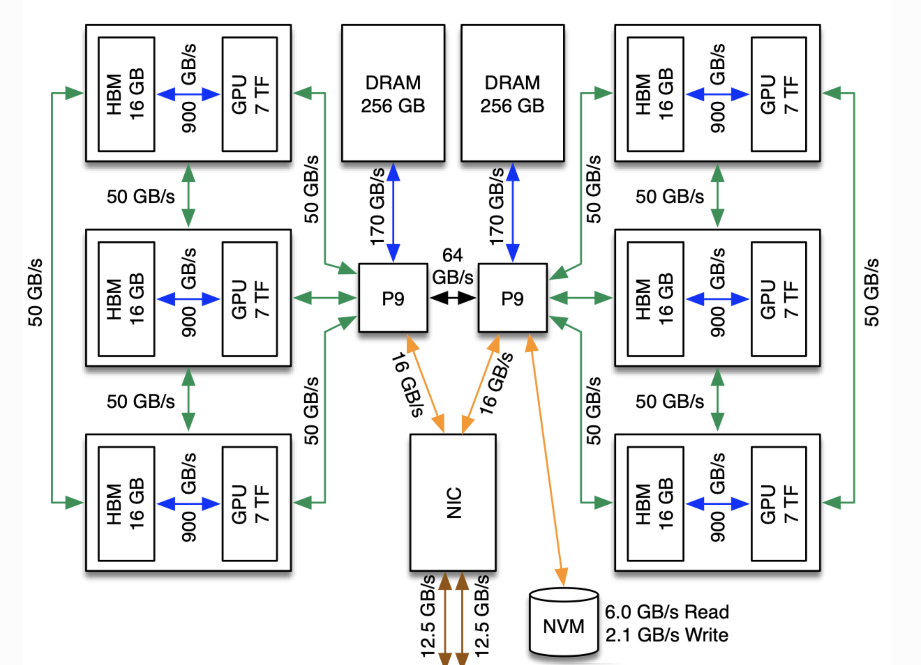
Ascent Crash Course
Ascent user guide: https://docs.olcf.ornl.gov/systems/ascent_user_guide.html
Workshop materials: https://github.com/justinlietz/ornl-cudaq-workshop
18 Summit nodes, each with 6 v100 GPUs.
Please limit time on interactive nodes so there’s enough to share
Job scripts and environment script is in the `batch_scripts` dir
Launch environment with `source load_env.sh`
Submit job with `bsub –L$SHELL <scriptname.sh>
A good test code is `targets.py` in the scripts folder
Everyone will be on the same login node, so only run small tests
The environment script uses a conda env, so try not to run it twice. If you do, just log out and back in again.

Slide 6
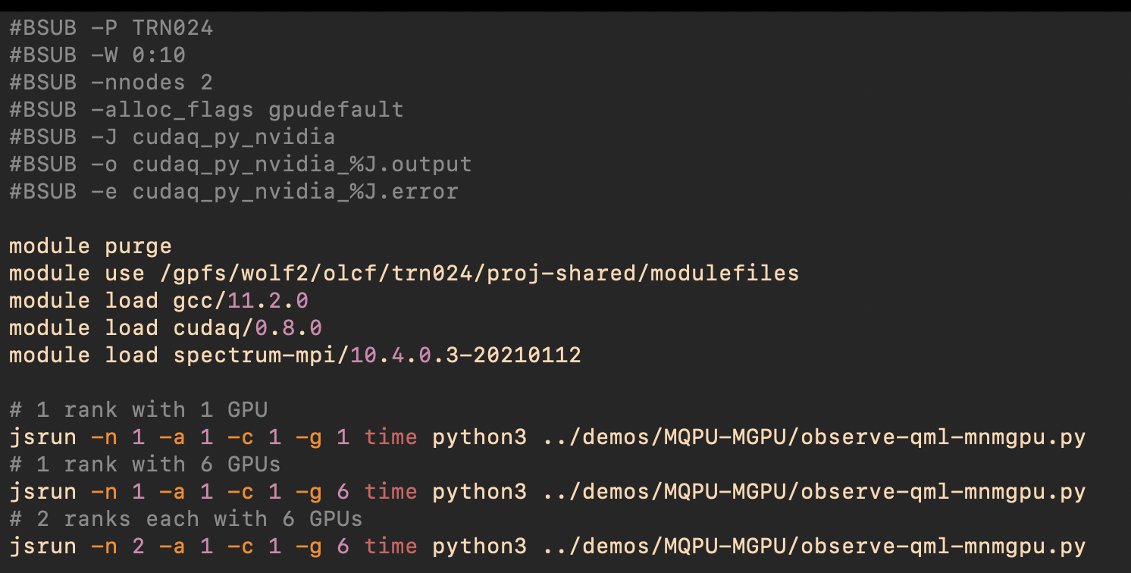
Ascent Crash Course
Our training account is TRN024
Example script showing how to use 1, 6, and 12 GPUs.
Notice resources are requested at the top, but then accessed only with jsrun command (even if only requesting 1 node)
This example script is in `batch_scripts` and uses a relative path to the script. You can `cd` here as well.

Slide 7
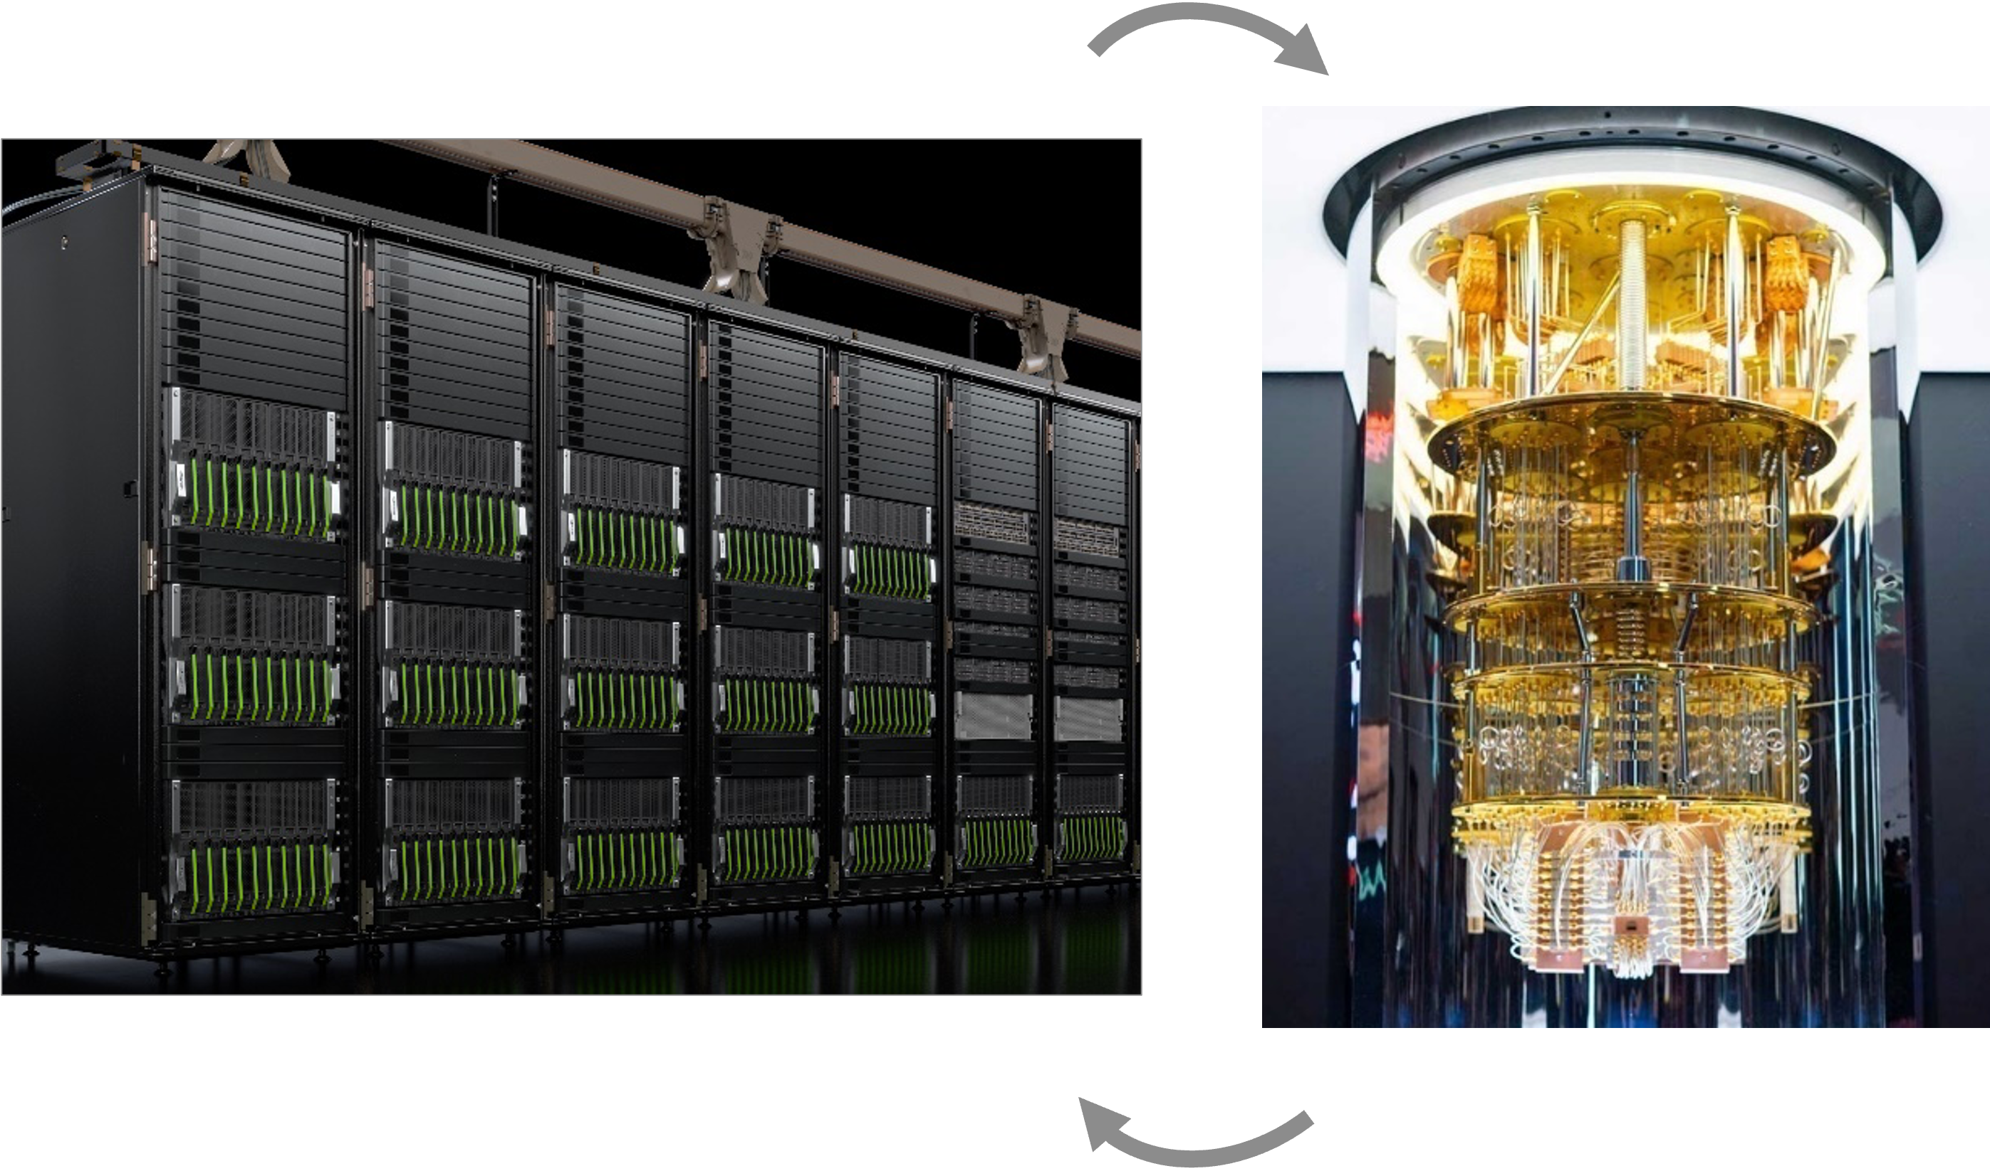
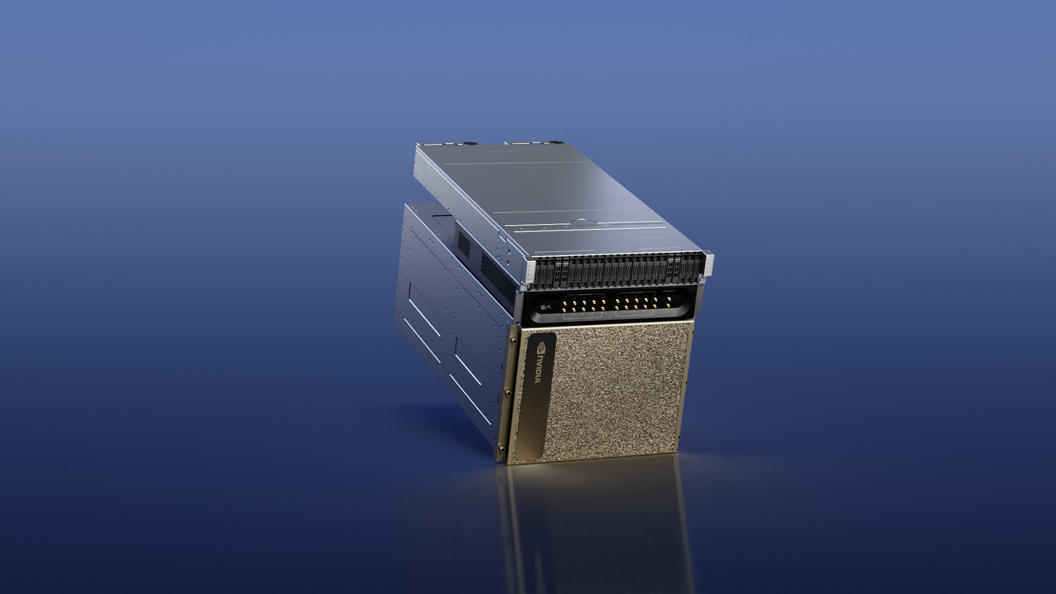
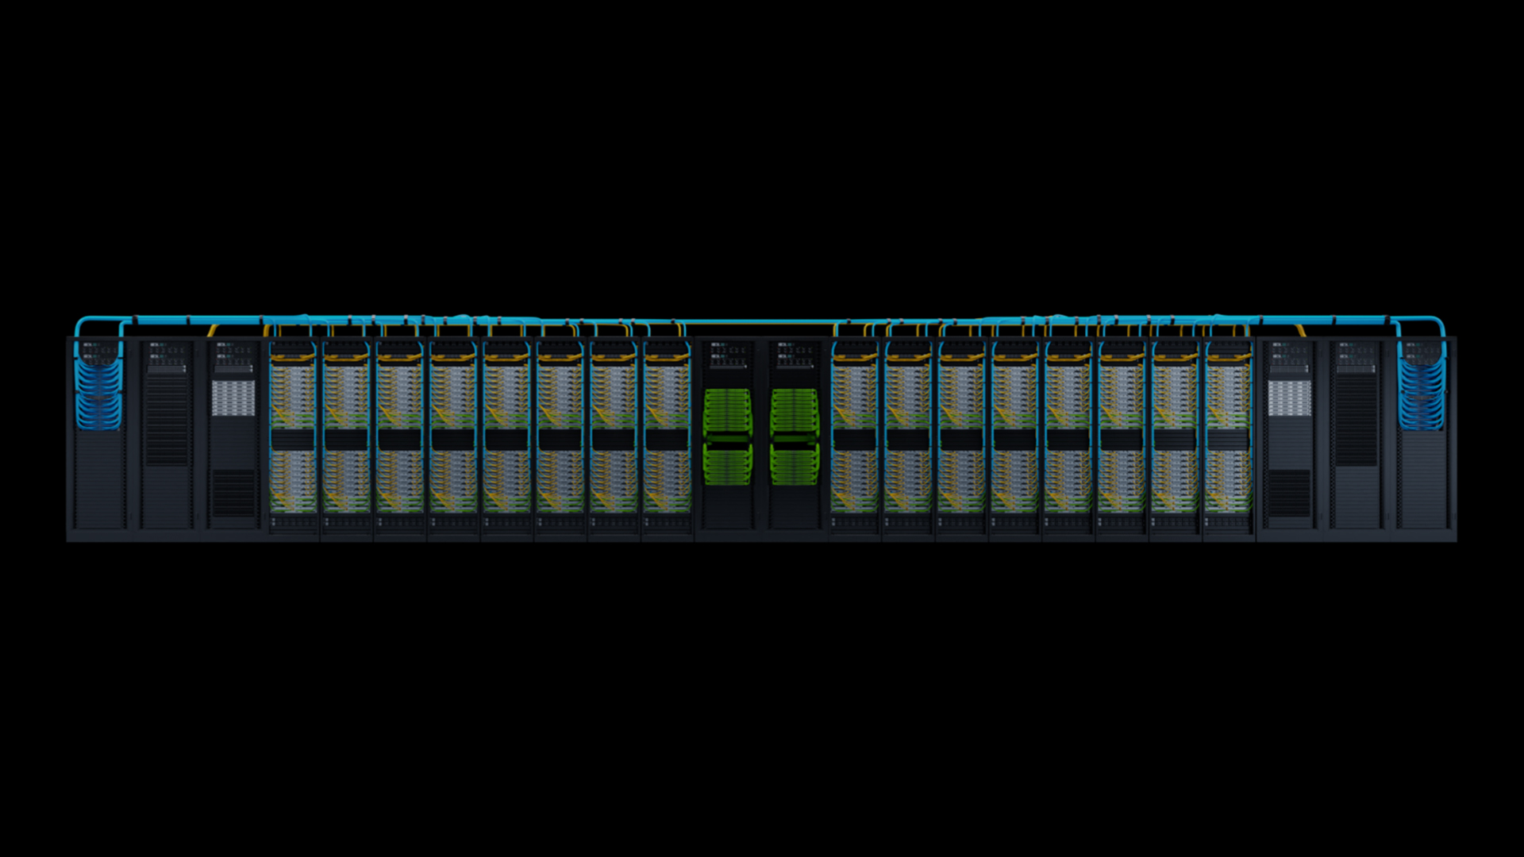
Quantum-Accelerated Supercomputing
GPU Supercomputers are the foundation of Quantum R&D
Simulation
HPC Quantum Integration
AI for Quantum
Quantum computers are small and error-prone
simulation is an essential tool
Today: Powerful simulators enable algorithm and application R&D – new approaches (e.g. tensor networks)
Future: Digital twins of quantum computers for design and architecture optimization
Useful quantum computing will be hybrid
Today: Enable domain scientists to start developing for QPUs, enable quantum researchers to use accelerated computing
Future: quantum computers will integrate tightly with supercomputers as accelerators and be co-programmed
Error correction, calibration, control, compilation are challenging computationally, real-time compute often needed
Accelerated computing and AI can solve these problems
Today: Enable AI research for all of the above
Future: Hybrid Quantum+AI supercomputer with low-latency link
Notes:
Simulation with cuQuantum.
Error correction, calibration, control all can benefit from classical compute/GPU.

Slide 8

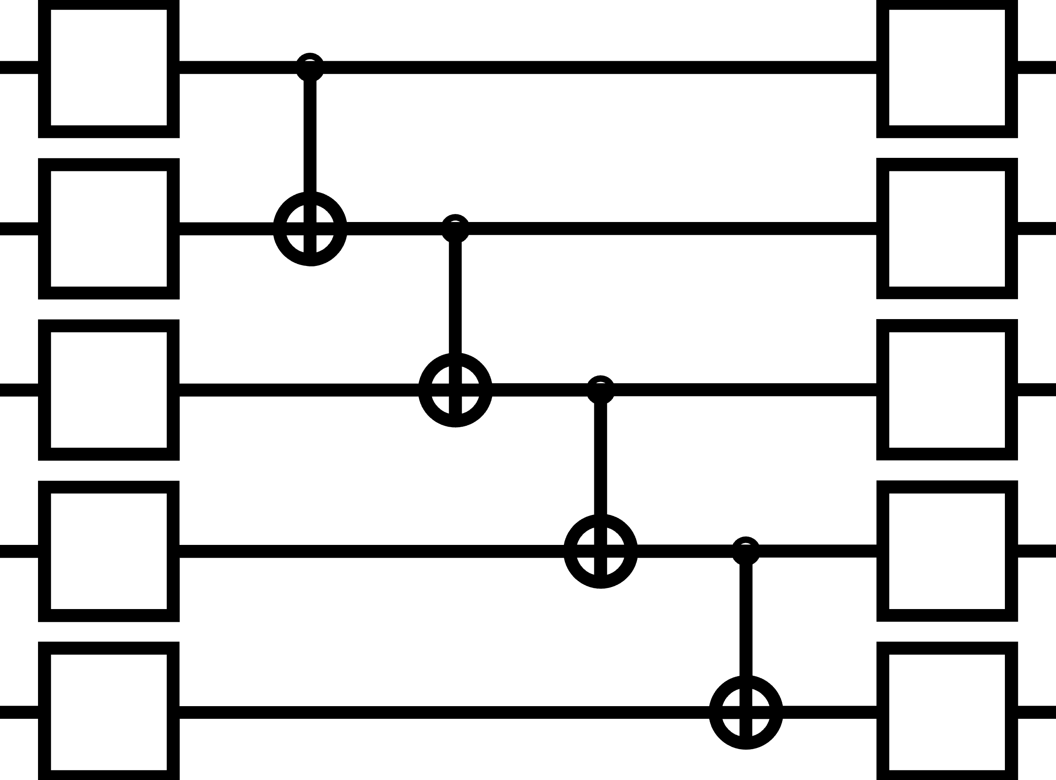

NVIDIA Quantum
Powering the Global Quantum Computing Community
Simulation
HPC Quantum Integration
AI for Quantum
Algorithm Design, Resource Estimation, QPU Design
QEC, Calibration, Algorithms
CUDA-Q
Libraries
Programming Model
Tools
Infrastructure
cuQuantum
DGX-Q
Quantum Simulation
Quantum Integrated
Computing
GPU
Supercomputing
Notes:
With all that in mind, we’ve put together a wholistic quantum/classical compute environment to bring all this together.
Programming models to enable developers and researchers, system level tools to integrate with the existing HPC ecosystem, libraries that sit on top of everything.
CUDA -> CUDA BLAS.
CUDA-Q builds on top of simulation stack

Slide 9
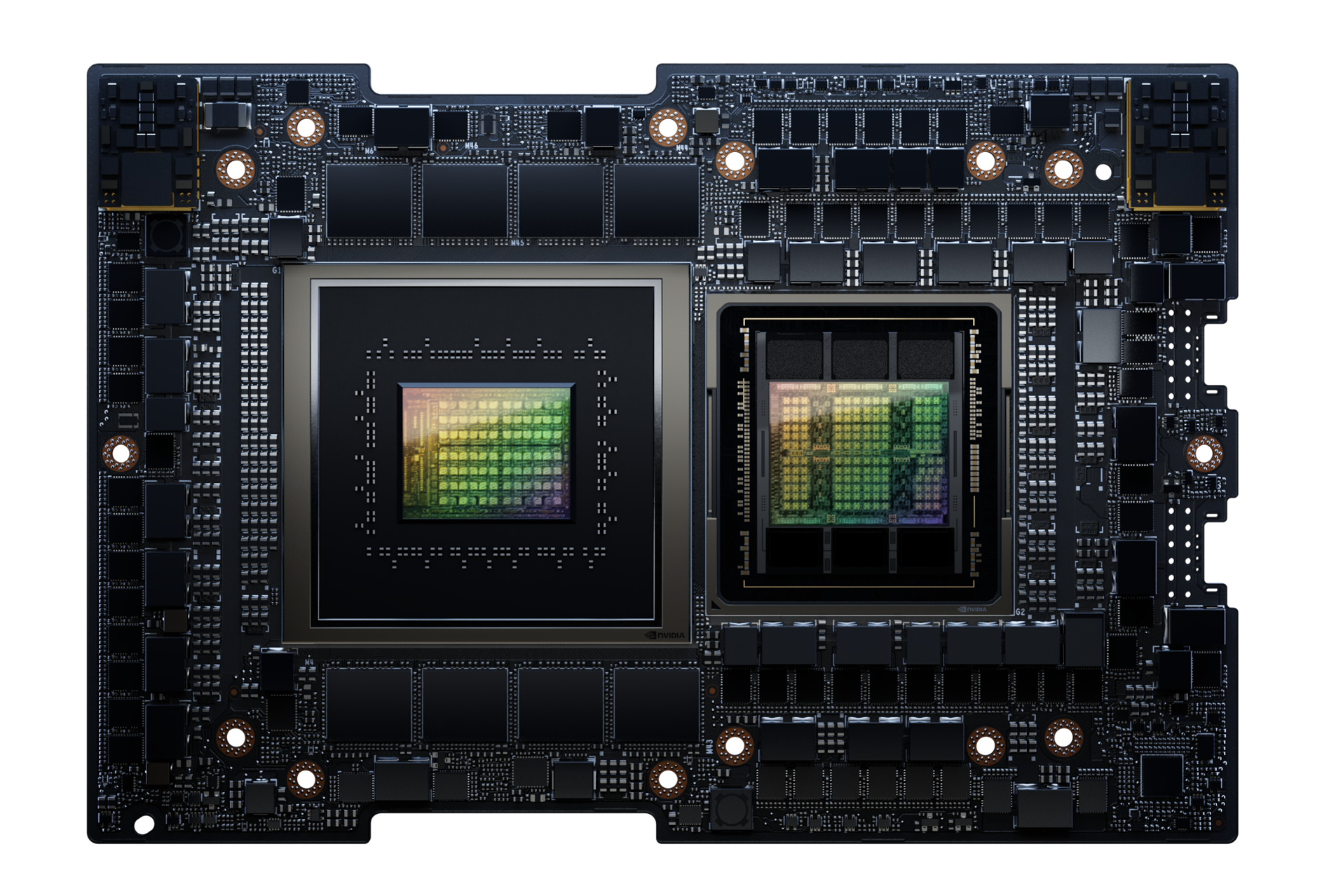
Grace Hopper: The Engine for Quantum Research
New Grace Hopper Deployments for Quantum Research
36 Qubit QPE Runtime
Simulation
Performance
1x Intel 8480CL + H100
298 (s)
1x GH200 Superchip
93 (s)
1x Intel 8480CL + H100
Simulation
Scale
1x GH200 Superchip
85% fewer GPUs required at any Qubit Scale
1-direction latency
1-10 seconds
Remote QPU, Web API
HPC-QC
Integration
Local QPU, Ethernet
10 microseconds
Typical Error Correction Budget
10 microseconds
DGX Quantum (GH200+OPX)
400 nanoseconds
Notes:
Grace Hopper enables both; much faster, and much larger, state vector and tensor network simulations
600GB mem, 900GB/s C2C

Slide 10
CUDA-Q
Enabling the QPU-accelerated GPU Supercomputer
A library-based C++ language extension that compiles directly to the MLIR
Focus – requirements, programming model, architecture

Slide 11




Requirements for Programming the Hybrid Quantum-Classical Node
What can we learn from experience in the purely classical programming space?
How to architect something like CUDA-Q?
Requirements
Performance
Familiar Programming Models
Integration with existing compilers and runtimes
C++ as the Least Common Denominator for Programming Languages
Leads to optimal performance / control for developers
Easily bind to high-level language approaches
Most HPC applications are in C++ or Fortran
Most AI / ML frameworks are in Python, but APIs are often bound to performant C code (or JIT compiled)
Python user-surface is necessary, but only part of solution
CUDA-like programming models
Cleanly separate device and host code
Direct vs library-based language extension
Split-compilation - map user kernel code to GPU instruction set (PTX)
// Kernel functions enable clean separation of
// host and device code
__global__ void VecAdd(float* A, float* B, float* C) {
int i = threadIdx.x;
C[i] = A[i] + B[i];
}
int main() {
...
// Invoke kernel from host code
VecAdd<<<1, N>>>(A, B, C);
...
}
Notes:
Want familiar programming models, python is very widely used.
User surfaces to bind to more performant code.

Slide 12


Leveraging Today’s Compiler Technologies
Leverage existing state-of-the-art and enable tight quantum-classical integration at IR level
Our goal should be - do not reinvent the wheel…
We want quantum extensions to classical
LLVM as the gold standard…
Toolchain for generating executable code
Modular
Control Flow is a solved problem
Recursive nature of the core abstractions (regions, blocks, operations)
MLIR – Framework for creating custom compiler IRs
Dialects and Dialect Composition
Progressive Lowering
Control Flow
Optimization, Transformation, and Conversion
Language level abstractions
GPU Dialect
CPU Dialect
…
Quantum Dialect
Dialect Composition
Combined Dialects
Quantum Optimization
Combined analysis and lowering of IR for heterogeneous system
Classical Optimization
Progressive Lowering
NVVM Dialect
LLVM
QIR Dialect
GPU
CPU
QPU
Notes:
We want to express quantum programs with classical logic, for loops, etc.
MLIR is composable and extensible. Dialect for each hardware target

Slide 13
The CUDA-Q Stack
Platform for unified quantum-classical accelerated computing
C++
Python
Kernel Expressions
JIT Kernel Expressions
Runtime
Kernel Expressions
JIT Kernel Expressions
Runtime
Frontends
CUDA-Q Formal Language Specification
Compiler Platform
CUDA-Q Intermediate Representation (MLIR)
cudaq-quake
Quake
CC
Func
Math
Arith
LLVM
cudaq-opt
(Quantum)
(Classical CFG)
(Kernels)
(Standard Math)
(Constants)
(Lowering Target)
cudaq-translate
nvq++ driver
Target Low-Level IR - Quantum Intermediate Representation (QIR, Profiles, LLVM IR), QASM ISA
libnvqir.so
Simulation (MGPU, MNMG, DM, TN)
Physical QPU (Quantinuum, IonQ, IQM, OQC)

Slide 14
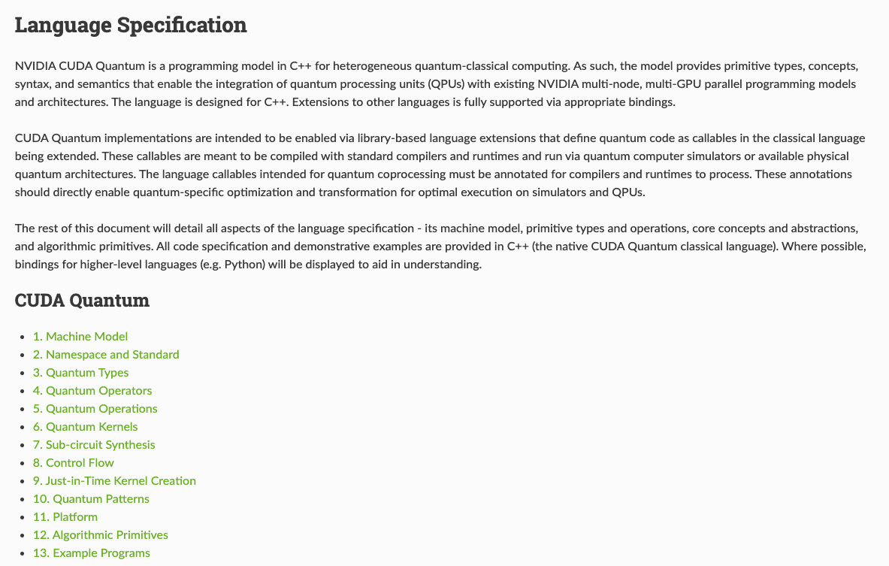
The CUDA-Q Language
Formal specification for quantum programming concepts that span classical language embeddings
CUDA-Q starts with a general language specification.
Language implementations must adhere to the specification
Meant to be classical language agnostic
Implementations now in C++ and Python
Defines common concepts for quantum programming
Quantum types and operations
Quantum kernels
Library APIs
This is an evolving specification.
We are interested in feedback and collaboration
There is a formal proposal process for contributions (coming soon)
https://nvidia.github.io/cuda-quantum/latest/specification/cudaq.html
Next: let’s dive into the specifics of the language…

Slide 15
GHZ State Example
Running on CPU
import cudaq
@cudaq.kernel
def ghz_state(N: int):
qubits = cudaq.qvector(N)
h(qubits[0])
for i in range(N - 1):
x.ctrl(qubits[i], qubits[i + 1])
mz(qubits)
cudaq.set_target("qpp-cpu")
n = 3
print("Preparing GHZ state for", n, "qubits.")
counts = cudaq.sample(ghz_state,n)
counts.dump()
Output:
Preparing GHZ state for 3 qubits.
{ 000:494 111:506 }
Notes:
Let’s start with a simple example, the GHZ state, where 3 or more qubits are being entangled.
Here you see the Python code using CUDA-Q to implement it.
A CUDA-Q kernel is a code or program that can be compiled and run on various devices. The kernel here gets a number of qubits as a parameter and entangles them using the control-X gate and performs a measurement using mz.
The kernel is being sampled multiple times (1000 by default)
For n=3, either all qubits are 0 or all are 1 so the distribution can be…

Slide 16
GHZ State Example
Running on GPU
import cudaq
@cudaq.kernel
def ghz_state(N: int):
qubits = cudaq.qvector(N)
h(qubits[0])
for i in range(N - 1):
x.ctrl(qubits[i], qubits[i + 1])
mz(qubits)
cudaq.set_target(“nvidia")
n = 29
print("Preparing GHZ state for", n, "qubits.")
counts = cudaq.sample(ghz_state,n)
counts.dump()
Output:
Preparing GHZ state for 29 qubits.
{ 00000000000000000000000000000:509 11111111111111111111111111111:491 }
Notes:
The previous example runs within seconds on a CPU, but what if we want to run more qubits?
Running on a CPU will result in an out of memory error, but I can run this code on my laptop GPU by setting the target to “nvidia” and can run the algorithm using up to 29 qubits.
Run on NVIDIA RTX A3000 Laptop GPU

Slide 17
What is a CUDA-Q Kernel?
Cleanly separate host code from quantum device code
struct phase_estimation {
template <typename StatePrep, typename Unitary>
void operator()(int numCountingQubits, int numStateQubits,
StatePrep && statePrep,
Unitary && oracle) __qpu__ {
// Allocate a register of qubits
cudaq::qvector q(numCountingQubits + numStateQubits);
// Extract sub-registers, one for the counting qubits
// another for the eigenstate register
auto& countingQubits = q.front(numCountingQubits);
auto& stateRegister = q.back(numStateQubits);
// Prepare the eigenstate
statePrep(stateRegister);
// Put the counting register into uniform superposition
h(countingQubits);
// Perform `ctrl-U^j`
for (int i = 0; i < numCountingQubits; ++i)
for (int j = 0; j < (1 << i); ++j)
cudaq::control(oracle, countingQubits[i],
stateRegister);
// Apply inverse quantum Fourier transform
iqft(countingQubits);
// Measure to gather sampling statistics
mz(countingQubits);
}
};
@cudaq.kernel
def phase_estimation(numCounting: int, numQubits : int,
statePrep : Callable[[cudaq.qview], None],
oracle : Callable[[cudaq.qview], None]):
# Allocate a register of qubits
q = cudaq.qvector(numCounting + numQubits)
# Extract sub-registers, one for the counting qubits
# another for the eigenstate register
countingQubits = q.front(numCounting)
stateRegister = q.back(numQubits)
# Prepare the eigenstate
statePrep(stateRegister)
# Put the counting register into uniform superposition
h(countingQubits)
# Perform `ctrl-U^j`
for i in range(numCounting):
for j in range(2**i):
cudaq.control(oracle, countingQubits[i],
stateRegister)
# Apply inverse quantum Fourier transform
iqft(countingQubits);
# Measure to gather sampling statistics
mz(countingQubits);
Any callable in the language
Annotated in some way
Quantum memory management
Kernels are composable
Control flow inherited from classical language
Automated multi-control synthesis
C++
Python
Enable generic application libraries
Ultimately a kernel defines a template for quantum circuits. Circuits are concretized / synthesized with runtime information.

Slide 18
What is a CUDA-Q Kernel?
Cleanly separate host code from quantum device code
__qpu__ double RWPE(int N, double mu, double sigma) {
cudaq::qubit q, r;
x(q);
while (i < N) { // while loops available
h(q);
rz(1-(mu / sigma), q);
rz(.25 / sigma, r);
x<cudaq::ctrl>(q, r);
rz(-.25 / sigma, r);
x<cudaq::ctrl>(q, r);
h(q);
if (mz(q)) { // Condition code on qubit measurements
x(q);
mu += sigma * .6065;
} else {
mu -= sigma * .6065;
}
sigma *= .7951;
i++;
}
return 2 * mu;
}
@cudaq.kernel
def RWPE(N: int, mu : float, sigma : float) -> float:
q, r = cudaq.qubit(), cudaq.qubit()
x(q)
while i < N:
h(q)
rz(1.-(mu / sigma), q)
rz(.25 / sigma, r)
x.ctrl(q, r)
rz(-.25 / sigma, r)
x.ctrl(q, r)
h(q)
if mz(q): // Condition code on qubit measurements
x(q)
mu += sigma * .6065
else:
mu -= sigma * .6065
sigma *= .7951
i += 1
return 2 * mu;
Dynamic circuits (control dictated by qubit measurement results) and user-defined return types fit into this model too.
Notes:
Random walk phase estimation, can return the phase that we are looking for by the return type.

Slide 19
Quantum Operations and Control Modifiers
Single qubit operations and compiler-synthesized controlled operations
__qpu__ void cnotKernel(cudaq::qubit& q, cudaq::qubit& r) {
x<cudaq::ctrl>(q, r);
}
__qpu__ void toBeAdjointed(cudaq::qubit& q, cudaq::qubit& r) {
h(q);
x(r);
x<cudaq::ctrl>(q, r);
ry(-M_PI_2, q);
}
__qpu__ void multipleWaysToExpressToffoli(std::size_t N) {
{
cudaq::qarray<3> q;
// Toffoli
x<cudaq::ctrl>(q[0], q[1], q[2]);
} // qubits deallocated at scope exit
{
cudaq::qvector q(N);
// Toffoli
cudaq::control(cnotKernel, {q[0]}, q[1], q[2]);
}
__qpu__ void showNegationAndAdjoint() {
cudaq::qvector q(2);
h<cudaq::ctrl>(!q[0], q[1]); // negated control
// adjoint modifier
t<cudaq::adj>(q[0]);
// compiler synthesizes the adjoint
cudaq::adjoint(toBeAdjointed, q[0], r[1]);
}
Quantum operations are unique functions that take a qubit reference and optional floating-point parameters.
CUDA-Q starts with a specification of logical single-target quantum operations
General multi-control operations are expressed via modification of these single-target operations
Control operations expressed with cudaq::ctrl modifier
Multi-qubit operations are synthesized by the compiler
Control qubits are first N-1 qubit arguments
Control qubits can be also negated with operator!()
Entire kernel expressions can be controlled with cudaq::control(...)
Adjoint kernels can be synthesized with cudaq::adjoint(...)

Slide 20
Quantum Operations and Control Modifiers
Single qubit operations and compiler-synthesized controlled operations
@cudaq.kernel
def cnotKernel(q : cudaq.qubit, r : cudaq.qubit):
x.ctrl(q, r)
@cudaq.kernel
def toBeAdjointed(q : cudaq.qubit, r : cudaq.qubit):
h(q)
x(r)
x.ctrl(q, r)
ry(-np.pi / 2, q)
@cudaq.kernel
def multipleWaysToExpressToffoli():
q = cudaq.qvector(3)
// Toffoli
x.ctrl(q[0], q[1], q[2]);
# Toffoli
cudaq.control(cnotKernel, [q[0]], q[1], q[2]);
@cudaq.kernel
def showNegationAndAdjoint(N : int):
q = cudaq.qvector(N);
h.ctrl(!q[0], q[1]); // negated control
# adjoint modifier
t.adj(q[0])
// compiler synthesizes the adjoint
cudaq.adjoint(toBeAdjointed, q[0], r[1]);
Quantum operations are unique functions that take a qubit reference and optional floating-point parameters.
CUDA-Q starts with a specification of logical single-target quantum operations
General multi-control operations are expressed via modification of these single-target operations
Control operations expressed with cudaq::ctrl modifier
Multi-qubit operations are synthesized by the compiler
Control qubits are first N-1 qubit arguments
Control qubits can be also negated with operator!()
Entire kernel expressions can be controlled with cudaq::control(...)
Adjoint kernels can be synthesized with cudaq::adjoint(...)

Slide 21
CUDA-Q Platform and Asynchronous Execution
Expose the underlying system architecture to the programmer
The system architecture model considers access to multiple quantum accelerators
CUDA-Q provides programmatic access to this configuration via the quantum_platform
Exposes a native platform that models a virtual QPU for every CUDA device.
Each CUDA device gets a cuQuantum-based simulator
Enables experimentation with distributed quantum computing and further simulation scalability
Targets: CUDA-Q programs are compiled to specific targets which define the multi-QPU granularity (or the physical QPU characteristics).
// Programmer can query info about the platform
auto& platform = cudaq::get_platform();
// Get number of QPUs available
auto numQpus = platform.num_qpus();
// Get the number of qubits on QPU 1
auto nQ1 = platform.get_num_qubits(1)
// Get QPU 0 connectivity.
auto connectivity = platform.get_connectivity(0);
// Async task execution on available QPUs
std::vector<std::future<double>> subs;
for (auto qpuIdx : cudaq::range(numQpus))
subs.emplace_back(cudaq::my_async_task(qpuIdx, ...));
auto sum = stdr::reduce(std::execution::par,
cudaq::when_all(subs), 0.0);
Node 0, MPI Rank 0
Node 1, MPI Rank 1
vQPU
(cuQuantum)
vQPU
(cuQuantum)
vQPU
(cuQuantum)
vQPU
(cuQuantum)
vQPU
(cuQuantum)
vQPU
(cuQuantum)
...
...
H100
H100
H100
H100
H100
H100
Notes:
Our machine model is heterogeneous from the start.
Get platform returns what the code is compiled to target.

Slide 22
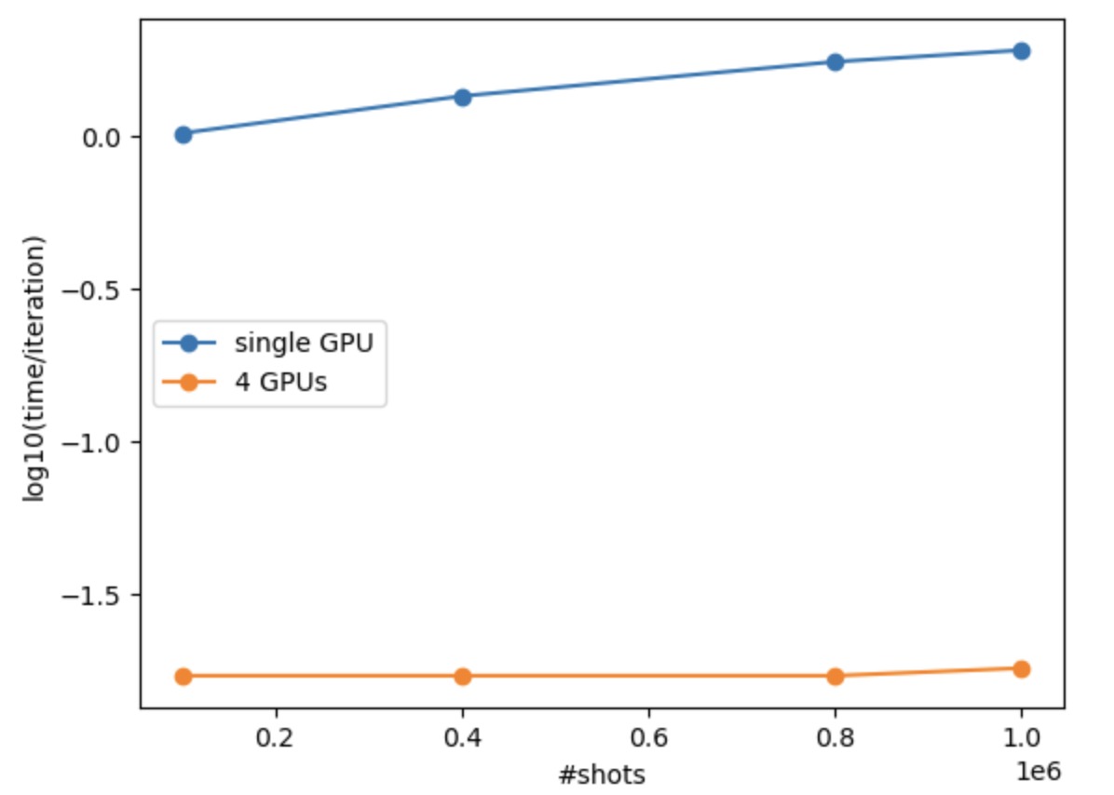
CUDA-Q Platform and Asynchronous Execution
Expose the underlying system architecture to the programmer
Example use-case – Sampling a Quantum Restricted Boltzmann Machine model
Find the ground state wavefunction for electronic Hamiltonian
Find ground state wavefunction for a Transverse Field Ising (TFS) model and Antiferromagnetic Heisenberg model (AFH)
Anomaly detection (DOI: https://doi.org/10.1038/s42005-023-01390-y )
Cybersecurity (arXiv:2011.13996)
Node 0, MPI Rank 0
Node 1, MPI Rank 1
vQPU
(id=0)
vQPU
(id=1)
vQPU
(id=N-1)
vQPU
(id=0)
vQPU
(id=1)
vQPU
(id=N-1)
...
...
H100
H100
H100
H100
H100
H100

Slide 23
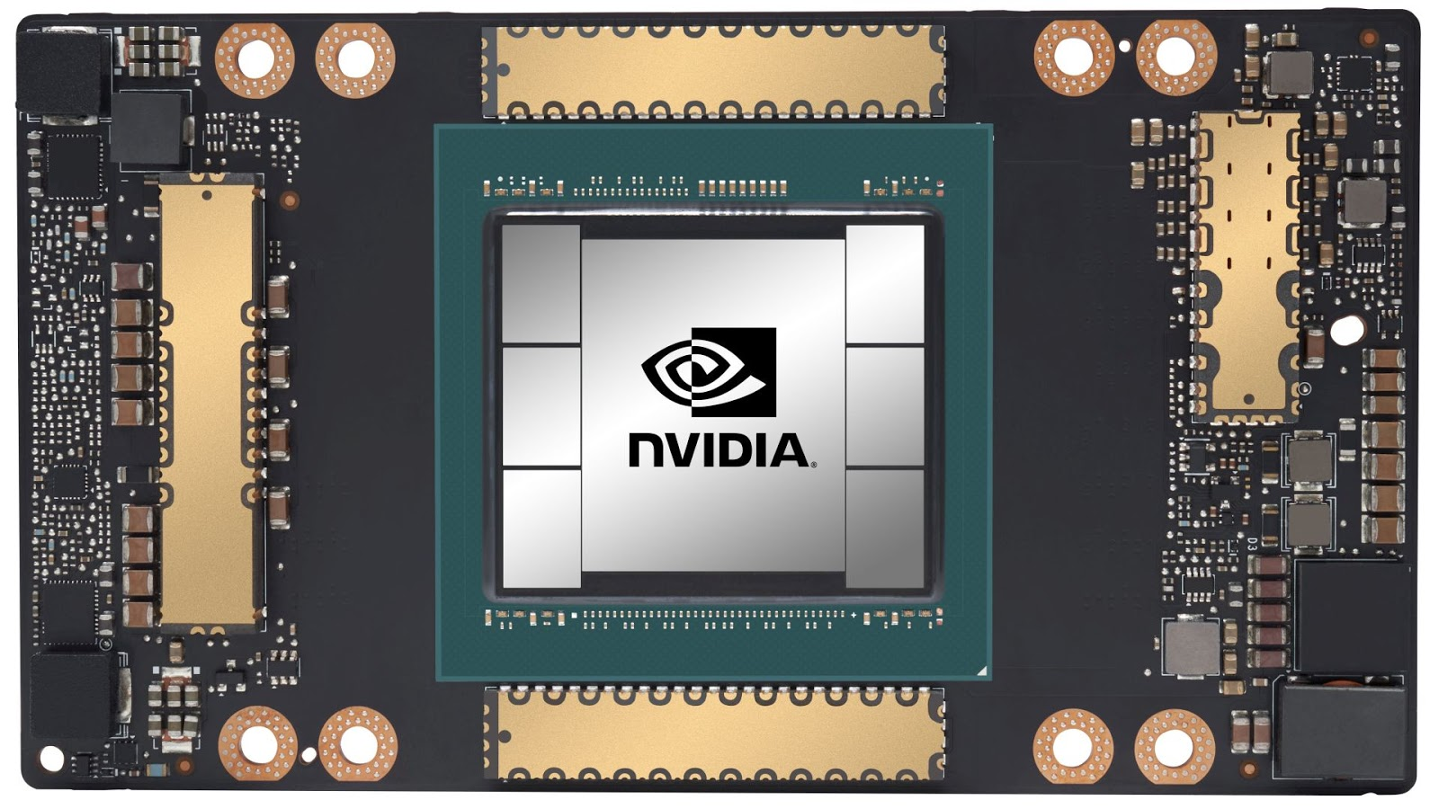


CUDA-Q Platform and Asynchronous Execution
Expose the underlying system architecture to the programmer
vQPU
vQPU
vQPU
vQPU
Local Virtualization (nvidia-mqpu)
Thread-based (NVIDIA device id) or MPI-based resource isolation.
Single GPU per vQPU.
Performant (minimal latency/overhead)
v0.6
Localhost Virtualization (remote-mqpu)
Remote client-server architecture.
Daemon processes (cudaq-qpud) = virtual QPUs.
HTTP (REST API) client-qpud communication.
Flexible GPU resource allocation and isolation ➔ enabling multi-GPU vQPU.
Communication overhead.
vQPU Daemon
vQPU Daemon
CUDA-Q
v0.7
Serverless Virtualization (nvqc)
Remote client-server architecture.
Similar to remote-mqpu with fully-managed server services.
Pre-configured daemon services, e.g., 1 GPU, 4 GPUs, or 8 GPUs/vQPU.
On-demand, unlimited* scalability (number of vQPUs)
NVQC
* theoretically, depending on NVCF auto-scaling capabilities

Slide 24

CUDA-Q Platform and Asynchronous Execution
Expose the underlying system architecture to the programmer
New params
Quantum Number Preserving (QNP) Ansatz
Energy
Gradients (one per parameters)
Optimizer
(L-BFGS)
- 60 qubits (MPS simulator)
- ~200 parameters per circuit layer.
- Demo target: 4 – 16 layers
CUDA-Q Solution:
- Parameter-shift gradient calculation: one parameter ➔ 2 circuits (+/- delta).
- Task-based virtualization: each iteration ➔ 1 + 2 * num_params tasks (each task is a circuit with different rotation angles).
- vQPUs grab tasks from the task pool.
- Executed on EOS: 59 nodes – 472 GPUs (each vQPU, aka GPU, only needs to run one task).
- Optimizer check-pointing to fit EOS wall-time limit.
EOS

Slide 25
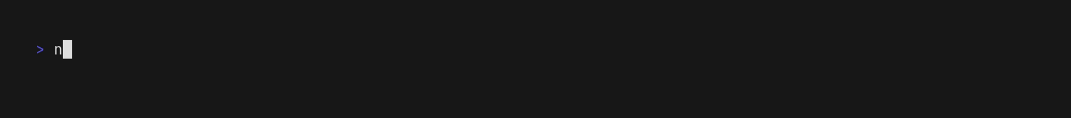

CUDA-Q Platform and Asynchronous Execution
Expose the underlying system architecture to the programmer
// Toy model: H2
cudaq::spin_op H(h2_data, /*nQubits*/ 4); auto ansatz = [](std::vector<double> thetas) __qpu__ {
… Quantum Number Preserving kernel.
qnp_fabric(q, numLayers, thetas);
};
// Get the number of virtual QPUs.
auto numQpus = platform.num_qpus();
auto objectiveDistributeGradients = [&](const std::vector<double> &x,
std::vector<double> &dx) -> double {
std::vector<std::vector<double>> allParams;
// Task lists: all parameter sets
allParams.reserve(2 * x.size() + 1);
allParams.emplace_back(x);
for (std::size_t paramId = 0; paramId < x.size(); ++paramId) {
… Shift params up and down
}
// Splice the task list (for QPUs)
const std::vector<std::vector<std::vector<double>>> paramsForQpus =
splitVec(allParams, std::min(numQpus, allParams.size()));
…
std::vector<cudaq::async_observe_result> expectation_futures; // Async. dispatch
for (std::size_t qpuId = 0; qpuId < numQpus; ++qpuId)
for (const auto &param : paramsForQpus[qpuId])
expectation_futures.emplace_back(
cudaq::observe_async(qpuId, ansatz, H, param));
… Do something else
// Retrieve results
std::vector<double> allData;
for (auto &fut : expectation_futures)
allData.emplace_back(fut.get().expectation());
// Return the <H> energy
const double energy = allData[0];
for (std::size_t paramId = 0; paramId < x.size(); ++paramId)
… Compute the gradients
dx[paramId] = (shiftPlus - shiftMinus) / 2.0;
…. return energy;
};
Platform agnostic programming (vQPU programming model)
Interchange backend, scale resources up and down
Task List
5X
Async. Dispatch to vQPUs
2X
Gather Data and Compute Gradients

Slide 26
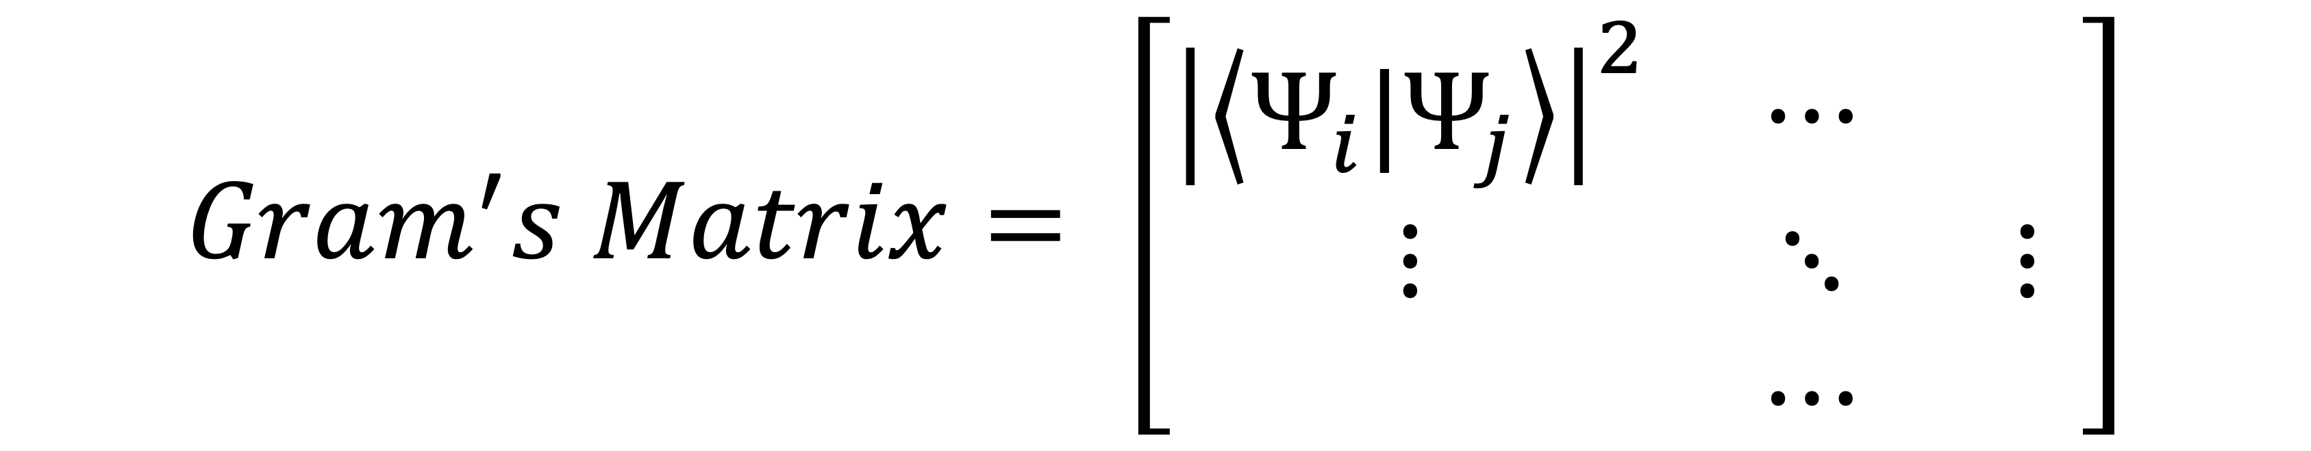
CUDA-Q Platform and Asynchronous Execution
Expose the underlying system architecture to the programmer
CUDA-Q Solution:
(1) Python-based mpi4py parallelization (user code)
(2) Direct access to GPU memory (tensor network state representation) (v0.8)
(3) CUDA integration: cupy and CUDA-aware MPI (data movement)
M Quantum Kernels (data samples)
Kernel₁(params)
import cudaq
import cupy as cp
import mpi4py
from mpi4py import MPI
comm = MPI.COMM_WORLD
# distribute the parameters across the available vQPU
param_vals_split = comm.scatter(param_vals, root = 0)
states_split = comm.scatter(states, root = 0)
# quantum computation (aka. get_state)
for i in range(param_vals_split.shape[0]):
states_split[i] = cudaq.get_state(kernel, param_vals_split[i])
# gather the results from the different ranks
results = comm.gather(states_split, root = 0)
# Post-processing to calculate the gram matrix which is the input to SVM
if rank == 0:
kets = cp.concatenate(results) bras = cp.transpose(cp.conj(kets))
gram_matrix = cp.zeros((m,m))
for i in range(m):
for j in range(m):
ith_bra = bras[:,i].reshape(1,-1) jth_ket = kets[j].reshape(-1,1) gram_matrix[i][j] = np.abs(jth_ket.overlap(ith_bra))**2
Quantum Machine Learning use case
(1)
…
Kernel_{M}(params)
(2)
(3)
$Gram^{′}s Matrix= \left[\begin{matrix}{\left|\left\langle Ψ_{i}|Ψ_{j}\right\rangle \right|}^{2} & ⋯ & \\ ⋮ & ⋱ & ⋮ \\ & ⋯ & \end{matrix}\right]$
Notes:
Support vector machine use case

Slide 27
CUDA-Q Compiler Platform
The compiler is composed of MLIR dialects and a set of discrete tools

Slide 28
The CUDA-Q Compiler Stack
Platform for unified quantum-classical accelerated computing
Compiler Platform
CUDA-Q Intermediate Representation (MLIR)
cudaq-quake
Quake
CC
Func
Math
Arith
LLVM
cudaq-opt
(Quantum)
(Classical CFG)
(Kernels)
(Standard Math)
(Constants)
(Lowering Target)
cudaq-translate
nvq++ driver
Target Low-Level IR - Quantum Intermediate Representation (QIR, Profiles, LLVM IR), QASM ISA
$ nvq++ -o simulatedExample.x example.cpp
$ ./simulatedExample.x
$ nvq++ -o gpuAccelerated.x example.cpp --target nvidia –I path/includes
$ ./gpuAccelerated.x
$ nvq++ -o noisyExample.x example.cpp --target density-matrix-gpu
$ ./noisyExample.x
$ nvq++ -o emulateQuantinuum.x example.cpp --target quantinuum --emulate
$ ./emulateQuantinuum.x
$ nvq++ -o quantinuumH2.x example.cpp --target quantinuum
$ ./quantinuumH2.x
CUDA-Q provides a collection of tools that enables the compilation of language representations to external representations like the QIR.
The nvq++ driver orchestrates this collection of these tools to produce hybrid quantum-classical executables and library code.
CUDA-Q targets define the architecture and native gate set for the specific QPU, as well as whether it is physical or emulated.

Slide 29
The CUDA-Q Compiler Stack
Platform for unified quantum-classical accelerated computing
Compiler Platform
CUDA-Q Intermediate Representation (MLIR)
cudaq-quake
Quake
CC
Func
Math
Arith
LLVM
cudaq-opt
(Quantum)
(Classical CFG)
(Kernels)
(Standard Math)
(Constants)
(Lowering Target)
cudaq-translate
nvq++ driver
Target Low-Level IR - Quantum Intermediate Representation (QIR, Profiles, LLVM IR), QASM ISA
__qpu__ double kernel(int N,
std::vector<double> params) {
int another = 5;
return params[0] + params[1];
}
module {
func.func @kernel(%arg0: i32, %arg1: !cc.stdvec<f64>) -> f64 {
%c5_i32 = arith.constant 5 : i32
%0 = cc.alloca i32
cc.store %arg0, %0 : !cc.ptr<i32>
%1 = cc.alloca i32
cc.store %c5_i32, %1 : !cc.ptr<i32>
%2 = cc.stdvec_data %arg1 : (!cc.stdvec<f64>) -> !cc.ptr<f64>
%3 = cc.compute_ptr %2[0] : (!cc.ptr<f64>) -> !cc.ptr<f64>
%4 = cc.load %3 : !cc.ptr<f64>
%5 = cc.stdvec_data %arg1 : (!cc.stdvec<f64>) -> !cc.ptr<f64>
%6 = cc.compute_ptr %5[1] : (!cc.ptr<f64>) -> !cc.ptr<f64>
%7 = cc.load %6 : !cc.ptr<f64>
%8 = arith.addf %4, %7 : f64
return %8 : f64
}
}
CC Dialect (Classical Computing)
Model C++ types and behavior
Control flow
Span-like types, callables, variables
Loop normalization and unrolling, lambda lifting, mem2reg, reg2mem, lower to LLVM CFG
This dialect will grow over time to support more and more of C++

Slide 30
The CUDA-Q Compiler Stack
Platform for unified quantum-classical accelerated computing
Compiler Platform
CUDA-Q Intermediate Representation (MLIR)
cudaq-quake
Quake
CC
Func
Math
Arith
LLVM
cudaq-opt
(Quantum)
(Classical CFG)
(Kernels)
(Standard Math)
(Constants)
(Lowering Target)
cudaq-translate
nvq++ driver
Target Low-Level IR - Quantum Intermediate Representation (QIR, Profiles, LLVM IR), QASM ISA
__qpu__ double kernel(int N,
std::vector<double> params) {
int another = 5;
return params[0] + params[1];
}
module {
func.func @kernel(%arg0: i32, %arg1: !cc.stdvec<f64>) -> f64 {
%c5_i32 = arith.constant 5 : i32
%0 = cc.alloca i32
cc.store %arg0, %0 : !cc.ptr<i32>
%1 = cc.alloca i32
cc.store %c5_i32, %1 : !cc.ptr<i32>
%2 = cc.stdvec_data %arg1 : (!cc.stdvec<f64>) -> !cc.ptr<f64>
%3 = cc.compute_ptr %2[0] : (!cc.ptr<f64>) -> !cc.ptr<f64>
%4 = cc.load %3 : !cc.ptr<f64>
%5 = cc.stdvec_data %arg1 : (!cc.stdvec<f64>) -> !cc.ptr<f64>
%6 = cc.compute_ptr %5[1] : (!cc.ptr<f64>) -> !cc.ptr<f64>
%7 = cc.load %6 : !cc.ptr<f64>
%8 = arith.addf %4, %7 : f64
return %8 : f64
}
}
MLIR Dialect Reuse
Leverage the work from the community
Functions, Math and Constants, and the LLVM Dialects
Optimizations from the community
Function inlining, canonicalization, common subexpression elimination
Lower to the QIR in MLIR before translating MLIR to LLVM IR (also get that for free)
Reuse other dialects

Slide 31
The CUDA-Q Compiler Stack
Platform for unified quantum-classical accelerated computing
Compiler Platform
CUDA-Q Intermediate Representation (MLIR)
cudaq-quake
Quake
CC
Func
Math
Arith
LLVM
cudaq-opt
(Quantum)
(Classical CFG)
(Kernels)
(Standard Math)
(Constants)
(Lowering Target)
cudaq-translate
nvq++ driver
Target Low-Level IR - Quantum Intermediate Representation (QIR, Profiles, LLVM IR), QASM ISA
__qpu__ double kernel(int N,
std::vector<double> params) {
int another = 5;
return params[0] + params[1];
}
llvm.func @kernel(%arg0: i32, %arg1: !llvm.struct<(ptr, i64)>) -> f64 {
%0 = llvm.mlir.constant(5 : i32) : i32
%1 = llvm.mlir.constant(1 : i32) : i32
%2 = llvm.alloca %1 x i32 : (i32) -> !llvm.ptr
llvm.store %arg0, %2 : i32, !llvm.ptr
%3 = llvm.alloca %1 x i32 : (i32) -> !llvm.ptr
llvm.store %0, %3 : i32, !llvm.ptr
%4 = llvm.extractvalue %arg1[0] : !llvm.struct<(ptr, i64)>
%5 = llvm.load %4 : !llvm.ptr -> f64
%6 = llvm.extractvalue %arg1[0] : !llvm.struct<(ptr, i64)>
%7 = llvm.getelementptr inbounds %6[1] : (!llvm.ptr) -> !llvm.ptr, f64
%8 = llvm.load %7 : !llvm.ptr -> f64
%9 = llvm.fadd %5, %8 : f64
llvm.return %9 : f64
}
MLIR Dialect Reuse
Leverage the work from the community
Functions, Math and Constants, and the LLVM Dialects
Optimizations from the community
Function inlining, canonicalization, common subexpression elimination
Lower to the QIR in MLIR before translating MLIR to LLVM IR (also get that for free)
Fully reuse LLVM dialect to go out to executable code

Slide 32
The CUDA-Q Compiler Stack
Platform for unified quantum-classical accelerated computing
Compiler Platform
CUDA-Q Intermediate Representation (MLIR)
cudaq-quake
Quake
CC
Func
Math
Arith
LLVM
cudaq-opt
(Quantum)
(Classical CFG)
(Kernels)
(Standard Math)
(Constants)
(Lowering Target)
cudaq-translate
nvq++ driver
Target Low-Level IR - Quantum Intermediate Representation (QIR, Profiles, LLVM IR), QASM ISA
Quake (Quantum Kernel Execution) Dialect
Model quantum types and operations
Quake can be in one of 2 forms:
Memory semantic model
easier to generate, QASM-like
Value semantic model
easier for optimizations
Optimizations and Transformations may be better suited for either of these forms
Track the use-def chains
Quake
Memory Semantic Model
Value Semantic Model
func.func foo(%veq : !quake.veq<2>) {
// Boilerplate to extract each qubit from the vector
%c0 = arith.constant 0 : index
%c1 = arith.constant 1 : index
%q0 = quake.extract_ref %veq[%c0] :
(!quake.veq<2>, index) -> !quake.ref
%q1 = quake.extract_ref %veq[%c1] :
(!quake.veq<2>, index) -> !quake.ref
// We apply some operators to those extracted qubits
// ... bunch of operators using %q0 and %q1 ...
quake.h %q0 : (!quake.ref) -> ()
// We decide to measure the vector
%result = quake.mz %veq : (!quake.veq<2>) -> cc.stdvec<i1>
// And then apply another Hadamard to %q0
quake.h %q0 : (!quake.ref) -> ()
// ...
}
func.func @foo() {
%0 = quake.null_wire
%1 = quake.null_wire
%2 = quake.h %0 : (!quake.wire) -> !quake.wire
%3 = quake.h %2 : (!quake.wire) -> !quake.wire
%4 = quake.h %3 : (!quake.wire) -> !quake.wire
%5 = quake.h %4 : (!quake.wire) -> !quake.wire
%6 = quake.h %5 : (!quake.wire) -> !quake.wire
%7 = quake.x %6 : (!quake.wire) -> !quake.wire
%8 = quake.x %7 : (!quake.wire) -> !quake.wire
%9:2 = quake.x [%8] %1 : (!quake.wire, !quake.wire) ->
(!quake.wire, !quake.wire)
%10:2 = quake.x [%9#0] %9#1 : (!quake.wire, !quake.wire) ->
(!quake.wire, !quake.wire)
%11:2 = quake.x [%10#0] %10#1 :(!quake.wire, !quake.wire) ->
(!quake.wire, !quake.wire)
return
}
Easier to find optimizations
Notes:
QASM is a memory semantic model. Get references to qubit, do operations on those references, and the state changes under the hood, but nothing is returned.
Value semantic model is the DAG, the graph structure of the code itself.
MLIR has tools for use-def chains, h acts on a wire, then h acts on the output of that wire. Those are an identity, can throw that out. Can pick out patterns in the Val Sem model.

Slide 33
The CUDA-Q Compiler Stack
Platform for unified quantum-classical accelerated computing
Compiler Platform
CUDA-Q Intermediate Representation (MLIR)
cudaq-quake
Quake
CC
Func
Math
Arith
LLVM
cudaq-opt
(Quantum)
(Classical CFG)
(Kernels)
(Standard Math)
(Constants)
(Lowering Target)
cudaq-translate
nvq++ driver
Target Low-Level IR - Quantum Intermediate Representation (QIR, Profiles, LLVM IR), QASM ISA
Lower C++ CUDA Quantum Kernels to Quake
Leverage Clang to build AST, walk the tree and map __qpu__ FunctionDecls to MLIR Functions containing Quake and CC operations
cudaq-opt - Transform / Optimize Quake
func.func ghzForLoop (%arg0: i32) {
%c0_i64 = arith.constant 0 : i64
... (skipped for brevity) ...
%0 = cc.alloca i32
cc.store %arg0, %0 : !cc.ptr<i32>
... (skipped for brevity) ...
quake.h %4 : (!quake.ref) -> ()
%5 = cc.alloca i64
cc.store %c0_i64, %5 : !cc.ptr<i64>
cc.loop while {
... (skipped for brevity) ...
cc.condition %11
} do {
... (skipped for brevity) ...
%11 = quake.extract_ref %3[%10] : (!quake.veq<?>, i64) -> !quake.ref
quake.x [%8] %11 : (!quake.ref, !quake.ref) -> ()
cc.continue
} step {
... (skipped for brevity) ...
}
__qpu__ void ghzForLoop(int N) {
cudaq::qreg q(N);
h(q[0]);
for (std::size_t i = 0; i < N - 1; i++)
x<cudaq::ctrl>(q[i], q[i + 1]);
mz(q);
}
cudaq-quake ghz.cpp | cudaq-opt --canonicalize

Slide 34
The CUDA-Q Compiler Stack
Platform for unified quantum-classical accelerated computing
Compiler Platform
CUDA-Q Intermediate Representation (MLIR)
cudaq-quake
Quake
CC
Func
Math
Arith
LLVM
cudaq-opt
(Quantum)
(Classical CFG)
(Kernels)
(Standard Math)
(Constants)
(Lowering Target)
cudaq-translate
nvq++ driver
Target Low-Level IR - Quantum Intermediate Representation (QIR, Profiles, LLVM IR), QASM ISA
Translate Quake to external representations
QIR
QIR Profiles
OpenQASM 2.0
IQM JSON
%Array = type opaque
%Qubit = type opaque
... (skipped for brevity) ...
define void @__nvqpp__mlirgen__function_test._Z4testv() local_unnamed_addr {
%1 = tail call %Array* @__quantum__rt__qubit_allocate_array(i64 2)
%2 = tail call i8* @__quantum__rt__array_get_element_ptr_1d(%Array* %1, i64 0)
%3 = bitcast i8* %2 to %Qubit**
%4 = load %Qubit*, %Qubit** %3, align 8
%5 = tail call i8* @__quantum__rt__array_get_element_ptr_1d(%Array* %1, i64 1)
%6 = bitcast i8* %5 to %Qubit**
%7 = load %Qubit*, %Qubit** %6, align 8
tail call void @__quantum__qis__h(%Qubit* %7)
tail call void @__quantum__qis__x(%Qubit* %4)
tail call void @__quantum__rt__qubit_release_array(%Array* %1)
ret void
}
__qpu__ void simple() {
cudaq::qubit q, r;
h(r);
x(q);
}
cudaq-quake ghz.cpp |
cudaq-opt --canonicalize |
cudaq-translate --convert-to=qir

Slide 35
The CUDA-Q Compiler Stack
Platform for unified quantum-classical accelerated computing
Compiler Platform
CUDA-Q Intermediate Representation (MLIR)
cudaq-quake
Quake
CC
Func
Math
Arith
LLVM
cudaq-opt
(Quantum)
(Classical CFG)
(Kernels)
(Standard Math)
(Constants)
(Lowering Target)
cudaq-translate
nvq++ driver
Target Low-Level IR - Quantum Intermediate Representation (QIR, Profiles, LLVM IR), QASM ISA
Translate Quake to external representations
QIR
QIR Profiles
OpenQASM 2.0
IQM JSON
%Qubit = type opaque
declare void @__quantum__qis__h__body(%Qubit*) local_unnamed_addr
declare void @__quantum__qis__x__body(%Qubit*) local_unnamed_addr
declare void @__quantum__rt__array_end_record_output() local_unnamed_addr
declare void @__quantum__rt__array_start_record_output() local_unnamed_addr
define void @__nvqpp__mlirgen__function_test._Z4testv() local_unnamed_addr #0 {
tail call void @__quantum__qis__h__body(%Qubit* nonnull inttoptr
(i64 1 to %Qubit*))
tail call void @__quantum__qis__x__body(%Qubit* null)
tail call void @__quantum__rt__array_start_record_output()
tail call void @__quantum__rt__array_end_record_output()
ret void
}
attributes #0 = { "EntryPoint" "requiredQubits"="2" "requiredResults"="0" }
__qpu__ void simple() {
cudaq::qubit q, r;
h(r);
x(q);
}
cudaq-quake ghz.cpp |
cudaq-opt --canonicalize |
cudaq-translate --convert-to=qir-base

Slide 36
The CUDA-Q Compiler Stack
Platform for unified quantum-classical accelerated computing
Compiler Platform
CUDA-Q Intermediate Representation (MLIR)
cudaq-quake
Quake
CC
Func
Math
Arith
LLVM
cudaq-opt
(Quantum)
(Classical CFG)
(Kernels)
(Standard Math)
(Constants)
(Lowering Target)
cudaq-translate
nvq++ driver
Target Low-Level IR - Quantum Intermediate Representation (QIR, Profiles, LLVM IR), QASM ISA
Translate Quake to external representations
QIR
QIR Profiles
OpenQASM 2.0
IQM JSON
OPENQASM 2.0;
include "qelib1.inc";
qreg var0[1];
qreg var1[1];
h var1[0];
x var0[0];
__qpu__ void simple() {
cudaq::qubit q, r;
h(r);
x(q);
}
cudaq-quake ghz.cpp |
cudaq-opt --canonicalize |
cudaq-translate --convert-to=openqasm

Slide 37
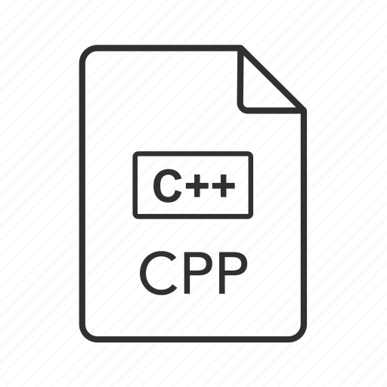

The CUDA-Q Compiler Stack
Platform for unified quantum-classical accelerated computing
Compiler Platform
CUDA-Q Intermediate Representation (MLIR)
cudaq-quake
Quake
CC
Func
Math
Arith
LLVM
cudaq-opt
(Quantum)
(Classical CFG)
(Kernels)
(Standard Math)
(Constants)
(Lowering Target)
cudaq-translate
nvq++ driver
Target Low-Level IR - Quantum Intermediate Representation (QIR, Profiles, LLVM IR), QASM ISA
no
nvq++ orchestrates the CUDA Quantum tools
Replace LLVM kernel function with MLIR one
MLIR Gen AST Visitor
MLIR Quake and CC Dialects
Opt Done?
yes
QIR
(LLVM IR)
object file
Clang
AST-to-LLVM CodeGen
Device Code Registration
object file
Link
nvq++
Transform CUDAQ Kernels via clang::RecursiveASTVisitor subtype
Standard LLVM IR for entire Translation Unit
Link-time Override
(redirect CUDAQ functions to MLIR functions)
object file

Slide 38
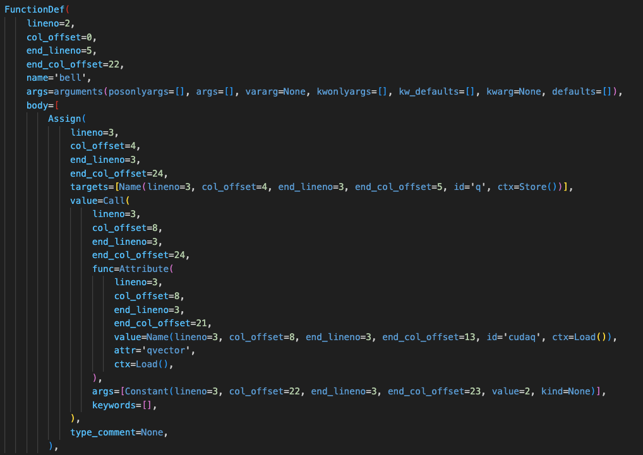
The CUDA-Q Compiler Stack
Platform for unified quantum-classical accelerated computing
Compiler Platform
CUDA-Q Intermediate Representation (MLIR)
cudaq-quake
Quake
CC
Func
Math
Arith
LLVM
cudaq-opt
(Quantum)
(Classical CFG)
(Kernels)
(Standard Math)
(Constants)
(Lowering Target)
cudaq-translate
nvq++ driver
Target Low-Level IR - Quantum Intermediate Representation (QIR, Profiles, LLVM IR), QASM ISA
AST Visitor
JIT compile, extract function pointer
@cudaq.kernel
def bell():
q = cudaq.qvector(2)
h(q[0])
x.ctrl(q[0], q[1])
Generate MLIR for
each node
JIT
Map function to Python AST
func.func @bell() {
%0 = quake.alloca !quake.veq<2>
%1 = quake.extract_ref %0[0] : (!quake.veq<2>) -> !quake.ref
quake.h %1 : (!quake.ref) -> ()
%2 = quake.extract_ref %0[1] : (!quake.veq<2>) -> !quake.ref
quake.x [%1] %2 : (!quake.ref, !quake.ref) -> ()
return
}
Visit / Walk AST nodes

Slide 39
CUDA-Q in Action
Dramatic performance improvements
Hybrid QPU-GPU applications

Slide 40
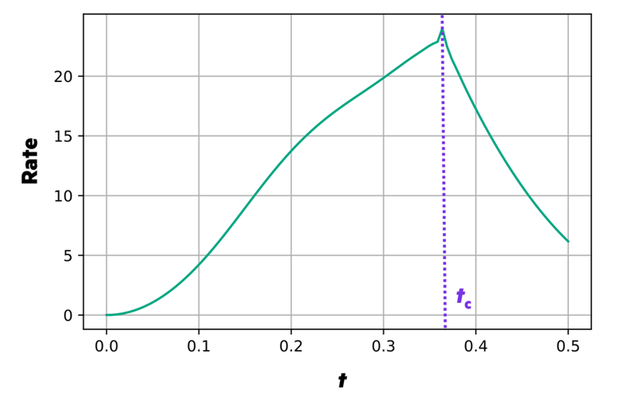
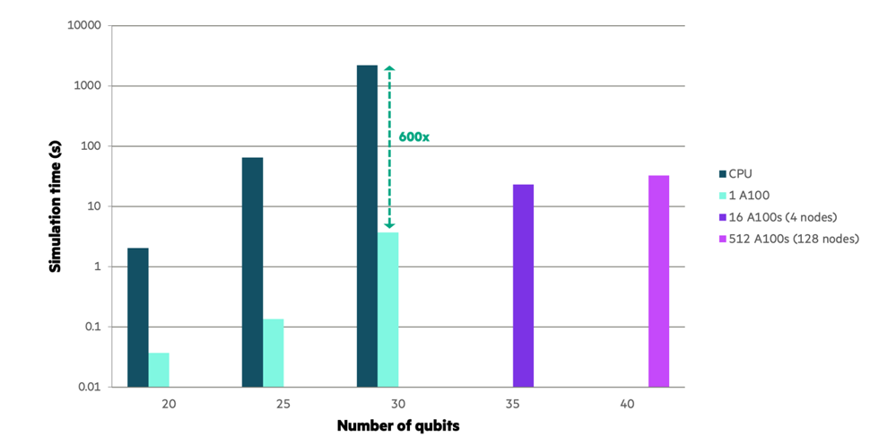
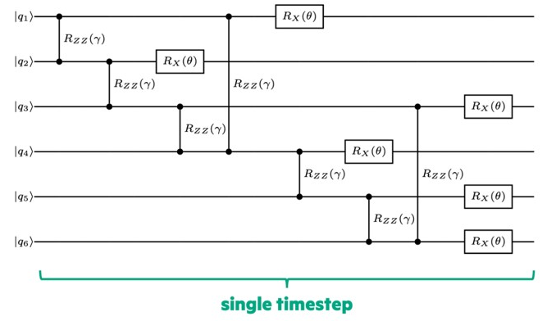
CUDA-Q in Action
Speed-ups for time-evolution of the transverse field Ising model (TFIM)
Collaboration with Hewlett Packard Labs
Study dynamical quantum phase transitions
Requires computation of overlap of initial state with time evolved state
Leverage NVIDIA multi-node, multi-GPU simulation backend.
Distributed state-vector simulator
600x performance increase over multi-threaded CPU approaches
@cudaq.kernel()
def tfimEvolve(timeStep: float, params: list[float]):
qubits = cudaq.qvector(40)
... Circuit, use input params ...
for time in range(finalTime):
state = cudaq.get_state(tfimEvolve, time, params)
overlaps.append(state.overlap(initialState))

Slide 41
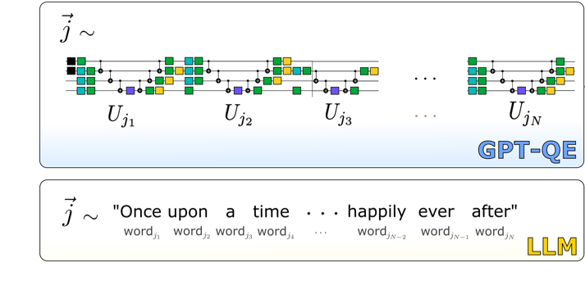
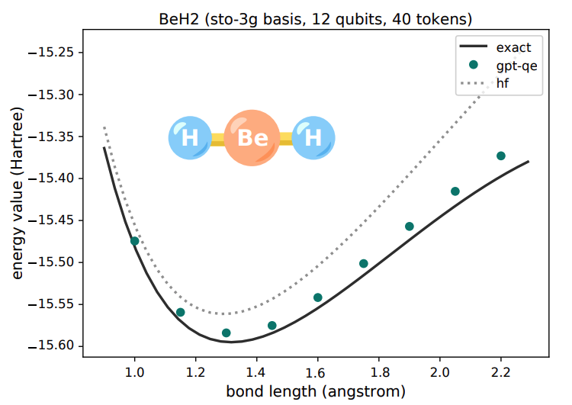


CUDA-Q in Action
GPT-QE - University of Toronto and St. Jude Children’s Research Hospital with CUDA-Q
BASF Chemistry Workflow QMCPACK + CUDA Quantum
Developed a novel Generative Pre-Trained Transformer-based (GPT) method for computing the ground-state energy of molecules of interest
The first demonstration of a GPT-generated quantum circuit in the literature
A powerful example of leveraging AI to accelerate quantum computing
Executed using CUDA-Q on A100 GPUs on Perlmutter
Opens the door to a wide variety of novel Generative Quantum Algorithms (GQAs) for drug discovery, materials science, and environmental challenges
https://arxiv.org/pdf/2401.09253.pdf
Notes:
alan aspuru-guzik group,
We’re not doing gradient computations on a quantum computer, instead executing static circuits, which are then used to train a model. All gradients are computed on the classical model with standard backprop.
This avoids messy issues with optimizing variational circuits like barren plateaus.

Slide 42
New Performance Updates

Slide 43
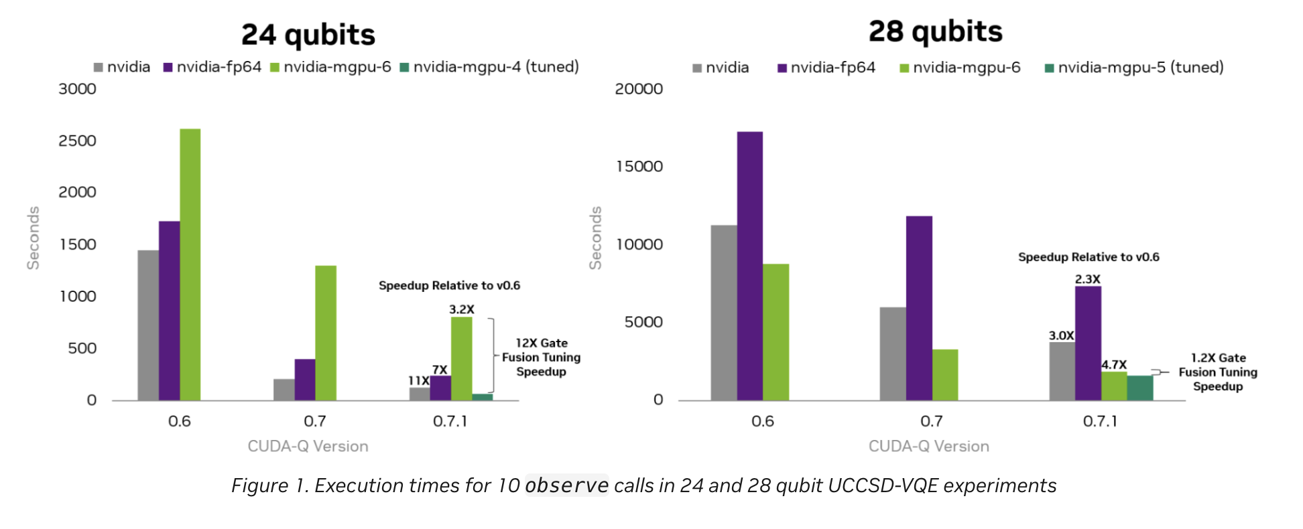
CUDA-Q performance updates
Improved Gate Fusion
https://developer.nvidia.com/blog/new-nvidia-cuda-q-features-boost-quantum-application-performance/

Slide 44
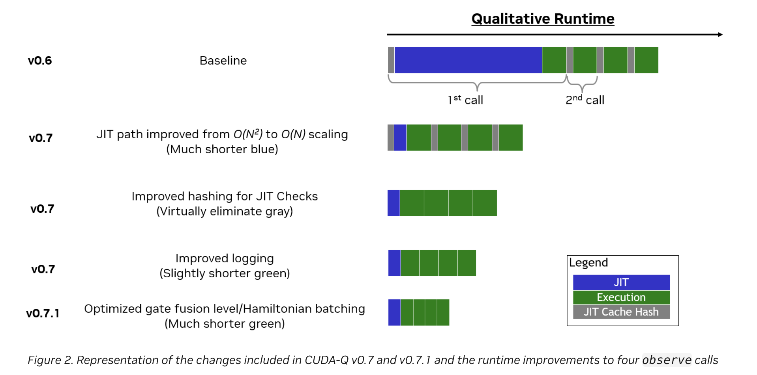
CUDA-Q performance updates
Improved JIT compilation and runtime
https://developer.nvidia.com/blog/new-nvidia-cuda-q-features-boost-quantum-application-performance/

Slide 45
CUDA-Q: State Handling Simulator
Connecting to a simulator
Simulator backend-specific state data representation (cudaq::SimulationState)
Abstract away state data and resources (e.g., simple arrays in GPU or host memory, distributed memory blobs, tensors’ data along with the tensor network description, etc.)
cudaq::state = user-facing class with simplified life-cycle management (RAII)
getAmplitude
Facilitate simulator-specific data accessor and overlap calculation, e.g., direct GPU memory access, multi-node multi-GPU data access (via MPI), tensor-based amplitude/overlap contraction, etc.
overlap
cudaq::SimulationState
toHost
Data import and export.
- Flat state vector export if required.
- Import from a flat state vector in host memory.
createFromData
Release managed resources, e.g., GPU memory
destroyState

Slide 46
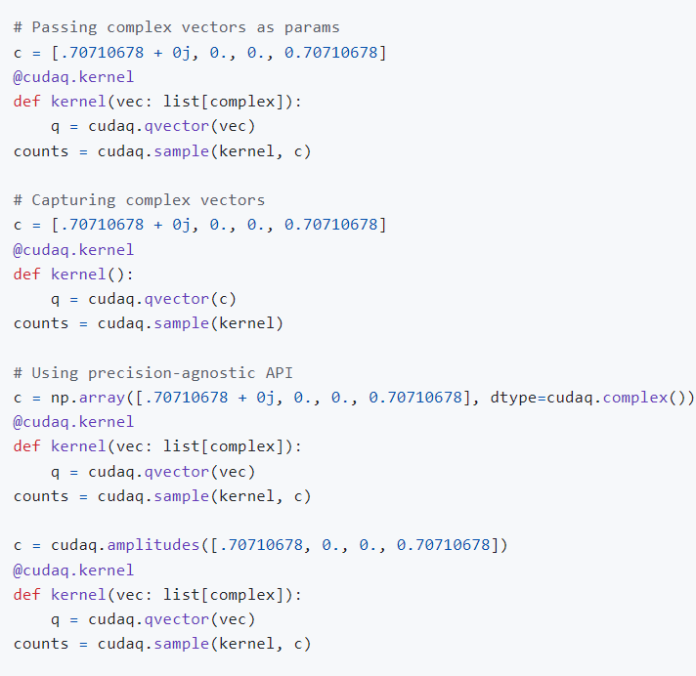
CUDA-Q: State Handling in Python
Python syntax and API
Syntax change connects qubits and state vectors explicitly
state expressed as various aggregates of data
vector of float, numpy.float32, numpy.float64
vector of complex, numpy.complex64, numpy.complex128
numpy array with float or complex dtypes
cudaq::state (next)
Design: kernels are converted to MLIR and JIT-ed
log(len(state)) qubits are created and initialized with the state
Code works for any simulation precision
Initializer data type might not match the simulation precision
Automatically convert to the correct precision
Issue a performance warning if copy of a vector is created
User code may be portable, simulator precision-agnostic
cudaq::complex, cudaq::real types
cudaq::amplitudes helper method that creates an array

Slide 47
CUDA-Q: State Handling Simulator
Connecting to a simulator
Simulator backend-specific state data representation (cudaq::SimulationState)
Abstract away state data and resources (e.g., simple arrays in GPU or host memory, distributed memory blobs, tensors’ data along with the tensor network description, etc.)
cudaq::state = user-facing class with simplified life-cycle management (RAII)
getAmplitude
Facilitate simulator-specific data accessor and overlap calculation, e.g., direct GPU memory access, multi-node multi-GPU data access (via MPI), tensor-based amplitude/overlap contraction, etc.
overlap
cudaq::SimulationState
toHost
Data import and export.
- Flat state vector export if required.
- Import from a flat state vector in host memory.
createFromData
Release managed resources, e.g., GPU memory
destroyState

Slide 48
CUDA-Q: State Handling Simulator
Connecting to a simulator
cudaq::get_state(Kernel, Args…)
qvector(cudaq::state)
Simulator
Simulator
Execute Kernel
Retrieve internal SimulationState data
Native state data to the backend, already in GPU memory, or properly MPI-distributed; tensors in GPU memory, etc.
Release internal state data
Initialize qubits’ state
FAST!
cudaq::state wrapped instance
Continue simulation
State Retrieval
State Initialization

Slide 49
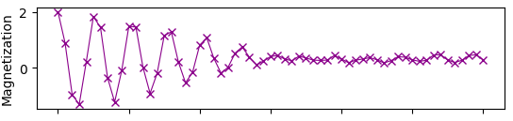
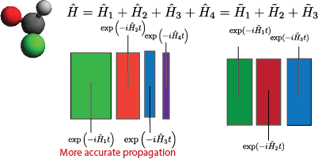
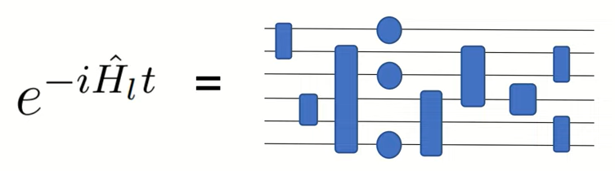
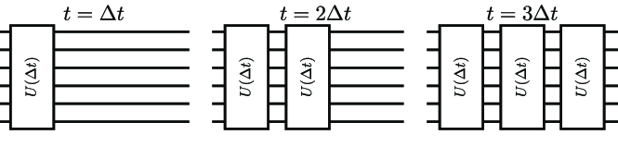
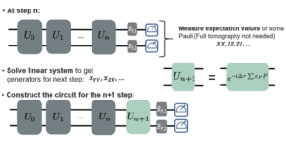
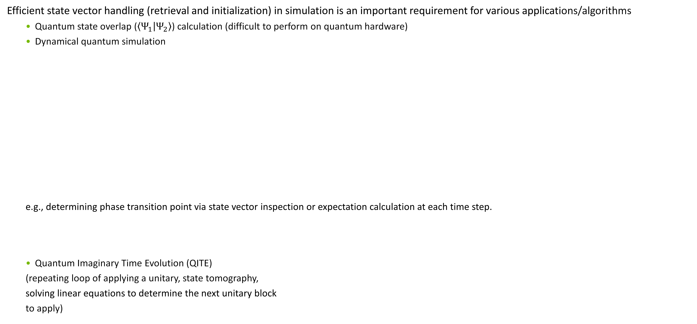
CUDA-Q: State Handling Example
Use Cases
Efficient state vector handling (retrieval and initialization) in simulation is an important requirement for various applications/algorithms
Quantum state overlap ($\left\langle Ψ_{1} | Ψ_{2}\right\rangle$) calculation (difficult to perform on quantum hardware)
Dynamical quantum simulation
e.g., determining phase transition point via state vector inspection or expectation calculation at each time step.
Quantum Imaginary Time Evolution (QITE)
(repeating loop of applying a unitary, state tomography,
solving linear equations to determine the next unitary block
to apply)
Notes:
The color bars at the end of U(dt) boxes represent the ‘states’ ➔ being able to cache these boxes means that we only need to run 1 U(dt) circuit box to simulate a new data point vs running from the beginning each time.

Slide 50
CUDA-Q: State Handling Example
Demo: Trotter Dynamical Simulation
CUDA-Q v0.7
CUDA-Q v0.8
struct trotter {
// Note: this runs Trotter simulation from the initial state
// (|00..00>) up to a certain time point (specified by num_step).
void operator()(int num_spins,
std::function<cudaq::spin_op(double)> td_ham,
double dt, int num_step) __qpu__ {
cudaq::qvector q(num_spins);
// Alternating up/down spins
for (int qId = 0; qId < num_spins; qId += 2)
x(q[qId]);
for (int j = 0; j < num_step; ++j) {
auto ham = td_ham(j * dt);
ham.for_each_term([&](cudaq::spin_op &term) {
const auto coeff = term.get_coefficient();
const auto pauliWord = term.to_string(false);
const double theta = coeff.real() * dt;
cudaq::exp_pauli(dt, q, pauliWord.c_str());
});
}
}
};
struct trotter {
// Note: This performs a single-step Trotter on top of an
// initial state, e.g., result state of the previous Trotter
// step.
void operator()(cudaq::state initial_state,
cudaq::spin_op ham, double dt) __qpu__ {
cudaq::qvector q(initial_state);
ham.for_each_term([&](cudaq::spin_op &term) {
const auto coeff = term.get_coefficient();
const auto pauliWord = term.to_string(false);
const double theta = coeff.real() * dt;
cudaq::exp_pauli(dt, q, pauliWord.c_str());
});
}
};
Qubit vector/register can be initialized in a specific state.
State data can be fed from a prior Trotter step to the next one.
State data is ‘native’ to the current simulator backend, e.g., GPU memory, tensor network form, etc.
Qubit vector/register must be allocated in an uninitialized state.
Starting the simulation from time 0 to time t at every step/data point.

Slide 51
CUDA-Q: State Handling Example
Demo: Trotter Dynamical Simulation
25-qubit Heisenberg Hamiltonian Simulation (100 Trotter steps)
custatevec (fp32) on A100
24X
Host vs. Device Memory State

Slide 52
CUDA-Q: State Handling Example
Host vs. GPU State
CUDA-Q v0.8
CUDA-Q v0.8
Passing the internal ‘state’
Passing the host memory vector
struct trotter {
// Note: This performs a single-step Trotter on top of an
// initial state, e.g., result state of the previous Trotter
// step.
void operator()(cudaq::state initial_state,
cudaq::spin_op ham, double dt) __qpu__ {
cudaq::qvector q(initial_state);
ham.for_each_term([&](cudaq::spin_op &term) {
const auto coeff = term.get_coefficient();
const auto pauliWord = term.to_string(false);
const double theta = coeff.real() * dt;
cudaq::exp_pauli(dt, q, pauliWord.c_str());
});
}
};
struct trotter {
// Note: This performs a single-step Trotter on top of an initial state vector
void operator()(std::vector<cudaq::complex>& initial_state_vector, cudaq::spin_op ham,
double dt) __qpu__ {
cudaq::qvector q(initial_state_vector);
ham.for_each_term([&](cudaq::spin_op &term) {
const auto coeff = term.get_coefficient();
const auto pauliWord = term.to_string(false);
const double theta = coeff.real() * dt;
cudaq::exp_pauli(dt, q, pauliWord.c_str());
});
}
};
State initialization from host memory is supported (all backends).
Extra overhead of data transfer.

Slide 53
CUDA-Q: State Handling Example
Host vs. GPU State Data
1.8X increase in runtime
GPU-Host data transfer
The data transfer overhead (ratio) depends on the number of qubits (data transfer size) vs. the depth of the circuit (GPU runtime). (Host – GPU BW << GPU memory BW)

Slide 54
Conclusion and Looking Forward
Areas of collaboration
CUDA-Q is a system-level programming model and compilation platform geared toward enabling quantum acceleration to existing GPU Supercomputing architectures
NVQ++ orchestrates a collection of modular tools enabling complex quantum-classical compilation workflows
Explore quantum algorithm simulation scalability on GPU Supercomputing with NVIDIA GPUs and CUDA-Q Multi-QPU virtualization

Slide 55
Resources
Links
CUDA-Q Repo for issues and contributions: NVIDIA/CUDA-Q uantum (github.com)
CUDA-Q documentation: CUDA-Q — NVIDIA CUDA-Q documentation
Quantum computing technical blogs: Tag: Quantum Computing | NVIDIA Technical Blog
CUDA-Q marketing page: CUDA-Q for Hybrid Quantum-Classical Computing | NVIDIA Developer
Documentation Reference
Quick Start
Multi-GPU Workflows
Simulator backends
Hardware backends
Python code examples
C++ code examples
Applications

